Slide 1
MySQL -> Flume -> Hive Cloudera VM
MUFADDAL HAIDERMOTA

Slide 2

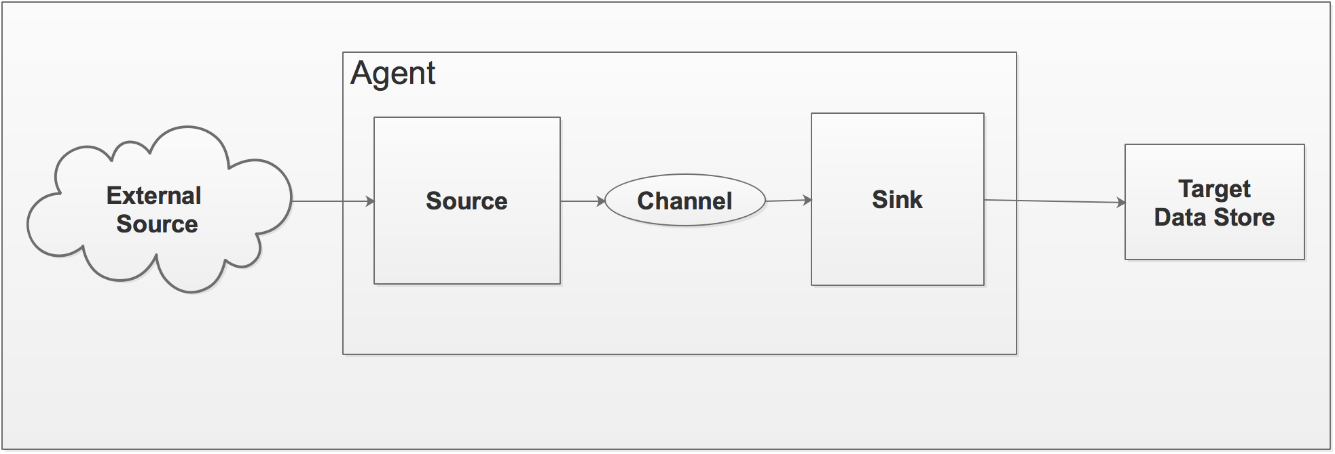
INTRODUCTION : FLUME
Flume is a distributed data transport and aggregation system for event- or log-structured data, principally designed for continuous data ingestion into Hadoop.

Slide 3
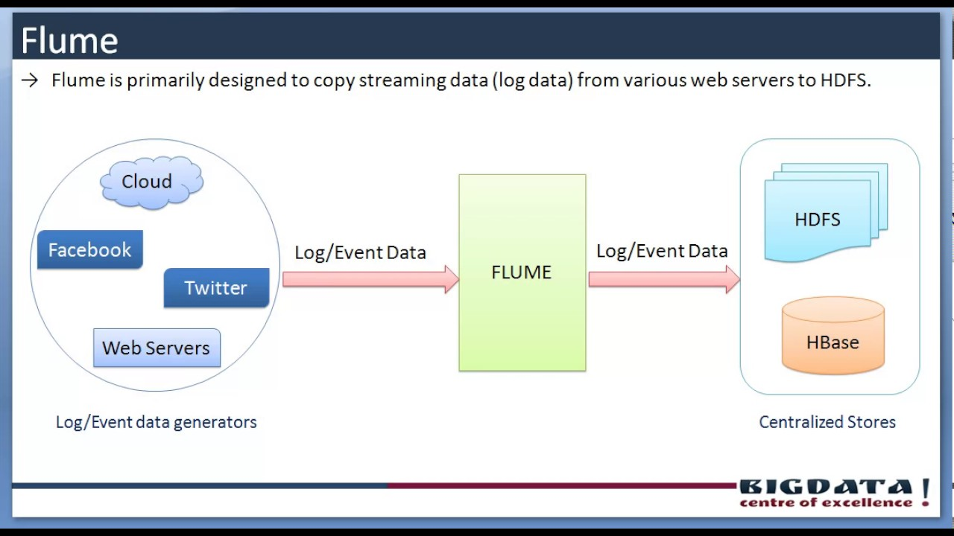
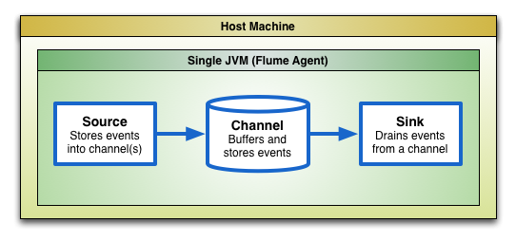
USE CASE
Send data (structured) from MySQL (Relational DB) to Hive.

Slide 4
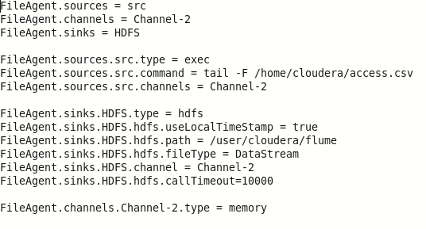
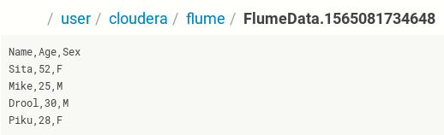
VERSION 1 : Local FS to HDFS

Slide 5

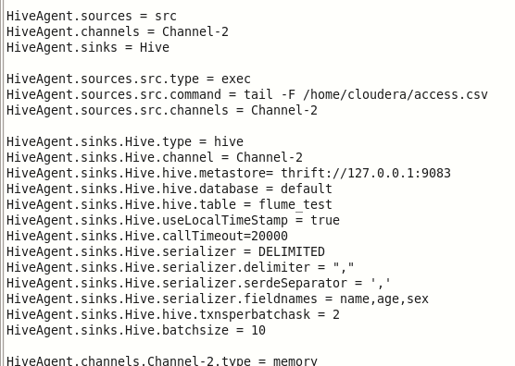


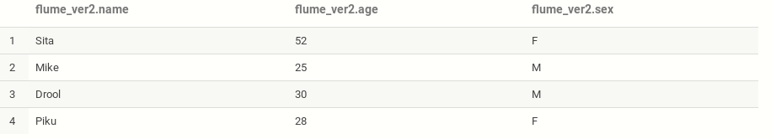

VERSION 2 : Local FS to Hive

Slide 6
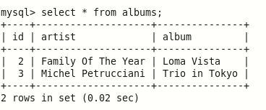
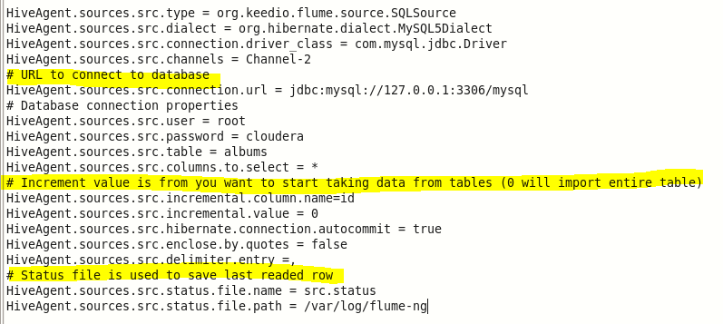
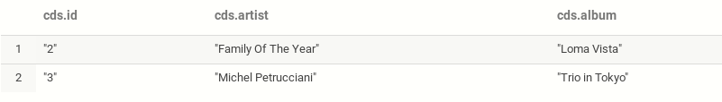
VERSION 3 : MySQL to Hive
Source Conf.

Slide 7
FLUME AGENT : SOURCE : MySQL
Flume Source a tool which receives data from the data generators.
Also, it transfers it to one or more channels as Flume events.
flume-ng-sql-source : to communicate with sql databases.
Property Name | Default | Description
channels | - | Connected channel names
type | - | The component type name, needs to be org.keedio.flume.source.SQLSource
hibernate.connection.url | - | Url to connect with the remote Database
hibernate.connection.user | - | Username to connect with the database
hibernate.connection.password | - | Password to connect with the database
table | - | Table to export data
status.file.name | - | Local file name to save last row number read
status.file.path | /var/lib/flume | Path to save the status file
start.from | 0 | Start value to import data
delimiter.entry | , | delimiter of incoming entry
enclose.by.quotes | true | If Quotes are applied to all values in the output.

Slide 8
FLUME AGENT : CHANNEL : MEMORY
A Flume channel is nothing but a transient store that receives the events from the source also buffers them until they sink consumes it.
In simple language, Flume Channel acts as a bridge between the sources and the sinks in Flume.
All the events are stored in an in-memory queue.
Moreover, it is ideal for flows which need higher throughput.
Also, those are prepared to lose the staged data in the event of agent failures.
Property Name | Default | Description
type | – | The component type name, needs to be memory

Slide 9
FLUME AGENT : SINK : HIVE
While it comes to store data into centralized stores we use Flume Sink component. It consumes events from the channel and then delivers it to the destination. However, it is possible to say that sink’s destination is might be another agent or the central stores.
Hive sink streams events containing delimited text or JSON data directly.
Once a set of events are committed to Hive, they become immediately visible to Hive queries.
Fields from incoming event data are mapped to corresponding columns in the Hive table.

Slide 10
Name | Default | Description
channel | –
type | – | The component type name, needs to be hive
hive.metastore | – | Hive metastore URI (eg thrift://a.b.com:9083 )
hive.database | – | Hive database name
hive.table | – | Hive table name
hive.txnsPerBatchAsk | 100 | Hive grants a batch of transactions instead of single transactions to streaming clients like Flume. This setting configures the number of desired transactions per Transaction Batch. Data from all transactions in a single batch end up in a single file. Flume will write a maximum of batchSize events in each transaction in the batch. This setting in conjunction with batchSize provides control over the size of each file. Note that eventually Hive will transparently compact these files into larger files.
callTimeout | 10000 | (In milliseconds) Timeout for Hive & HDFS I/O operations, such as openTxn, write, commit, abort.
serializer |  | Serializer is responsible for parsing out field from the event and mapping them to columns in the hive table. Choice of serializer depends upon the format of the data in the event. Supported serializers: DELIMITED and JSON
useLocalTimeStamp | false | Use the local time (instead of the timestamp from the event header) while replacing the escape sequences.

Slide 11

THANK YOU
https://data-flair.training/blogs/apache-flume-tutorial/
https://github.com/keedio/flume-ng-sql-source
https://flume.apache.org/FlumeUserGuide.html
https://dzone.com/articles/how-configure-mysql-metastore

